Slide 1
Ukraine: between Democracy and Gray Zone
Political System, Civil Society and Reform Perspectives

Slide 2
Political System
Parliamentary-Presidential Republic (changed in 2004, in 2010, 2014)
High role of Elections as a way to change authorities (unlike other Post-Soviet states)
Political Pluralism
Participation in International Organizations (UNO, Council of Europe, WTO, OESC), high orientation on external support

Slide 3
4 Ukrainian Presidents (alive) in December 2013

Slide 4
Political Parties
316 Parties registered (79 registered in 2015, 38 in 2014)
But only about 30-40 of them running elections
Most popular ones traditionally associated with oligarchs or local chiefs:
Petro Poroshenko Bloc (“Solidarnost”+ Udar Vitaliy Klitchko)
Fatherland “Batkivshina” (Yuliya Timoshenko)
Radical Party of Oleh Lyashko (sponsored by Serhiy Liovochkin)
Oppositional Bloc (sponsored by Rinat Akhmetov)
Ukrop, Vidroghennya, Samopomich (sponsored by Igor Kolomoiskiy)

Slide 5
Political Parties
From 2016 provided state’s financial support and strict accountability for political parties, which gained more 2% of voters on a last elections
New Legislation on Local Elections eliminated single-district candidates for cities and regional councils, established two-round elections for large cities mayors, which increase influence of political parties, but made them even more populistic
“New” parties like Democratic Alliance, Syla Lyudey (People’s Power) increase their presence in councils, using co-funding and horizontal connections

Slide 6
Political System: Gray Zone features
Corruption (Rank 130/168 states )
Instability of political system (conflicts in Parliament, on local level, rapid changes of parties’ electoral support, new border-lines in electoral landscape)
Oligarchs still impact politics sponsoring political parties and owning Media
Dependent and ineffective Courts
Rigid and corrupted middle-level bureaucracy

Slide 7
Roots of Separatism
Soviet Legacy (industrial, social and lingual)
Privatization on 1992-1996 created regional industrial and political clans, corny-economy and Rule BY Law in spite Rule OF Law
During 2002-2012 Parties used regional diversities, speculated on lingual, historical and geopolitical issues
Myth “Donbass feeding all Ukraine”, fear to loose political control and influence, budget subsidies after Yanucovich ousted
Russian Media propaganda, training of leaders, creation NGO
Poverty, distrust in Ukrainian state authorities (motto “pensions and salaries as in Russia”)

Slide 8
Russian Project “Novorossia” failed, but undeclared war still going
What they wanted
What they get

Slide 9
Conflict afterwards
Crimea Peninsula occupied, part of Donetsk and Luhansk oblast uncontrolled
About 8 000 of died and wounded during 2014-2015 (UN statistics)
1 014 500 of IDPs (mostly placed in Eastern Ukraine)
Challenges for social policy (IDPs, Anti Terroristic Operation veterans, replaced institutions etc)
Unmarked and unsecure state borders

Slide 10
Internally Displaced Persons in Ukraine

Slide 11
Gray Zone Risks
Frozen Conflict, weak State’s sovereignty
Militarization of society, uncontrolled and unknown number of guns
Poorest state in Europe (GDP 3082 $ per Capita), economical crisis and shadowed economy
Risk of new street protests, pro-Russian revenge and even Russian invasion

Slide 12
Ukrainian Rights: marginals or a real power?

Slide 13
“Ukrainian Rights”
Extraordinary Parliamentary Elections 2014 results
Right Sector – 1,8 % of voters support;
Dmytro Yarosh 0,7 % on Presidental Elections
Svoboda – 4,7 % in 2014 vs 10 % in 2012,
Oleh Tyagnybok 1.16 % on Presidental Elections
Andriy Biletskyu (Azov) – won single-member district as independent candidate in Kyiv in 2014

Slide 14
Ukrainian Rights: perspectives
Public attention to ATO and risk of ‘real’ war with Russia decreased, caused by economy issues, “normalization” of conflict situation
Discreditation of “heroes” and volunteering battalions in some Media, prosecution and trials for corruption, embezzlement of public funds and state supplies
Support of European course by majority of population, fears of Third Maidan
Internal ideological migration from radical ethnic nationalism to more centrist or traditional values (family, patriotism, decommunization) – to get more voters support (“Right Sector”, Biletskiy)

Slide 15
Civil Society: Third Sector
More than 80 000 NGO registered
Active volunteers movement (especially in Kharkiv and Dniepropetrovsk, where in 2014-2015 they assumed the functions of state bodies, helping IDPs and Army)
Unconventional acts (“garbage lustration”, vandalism toward communistic memorials) coexisting with wide educational, charities, conflict prevention initiatives, human rights movements, civil diplomacy etc.
Analytical and Experts Platforms (RPR, CVU, Opora) engaged in policy-making, monitoring and advocacy

Slide 16
Civil Society: Media
Media-holdings concerned to oligarchs, but due to competition between them could give comparatively objective view
Poroshenko owns his own television network, Fifth Channel, and has rebuffed press freedom groups’ calls for him to sell it. Among other key media owners are Dmytro Firtash (Inter), Ihor Kolomoysky (1+1), Rinat Akhmetov (“Ukraine”-TV), and Viktor Pinchuk (Novy Kanal, STB, ICTV).

Slide 18
Civil Society: Media
+ 2 points in Freedom House ranking during 2015 and – 8 % of people’ trust
Fight again Russian propaganda, banned 14 Russian channels, barred Russian journalist to enter the country
Ministry of Information established: fears of censorship
Slow process of setting up Public media, especially in regions

Slide 19
Public Opinion
Diverse due to region – especially towards NATO, historical memory, decommunization and conflict
Common all over Ukraine in distrust on state authorities, political parties and leaders
New lines of cleavages (Maidan/ Antimaidan, proUkrainian/ proRussians, for deccomunization) inside Southern and Eastern regions

Slide 20
Kharkiv, Spring 2014

Slide 21
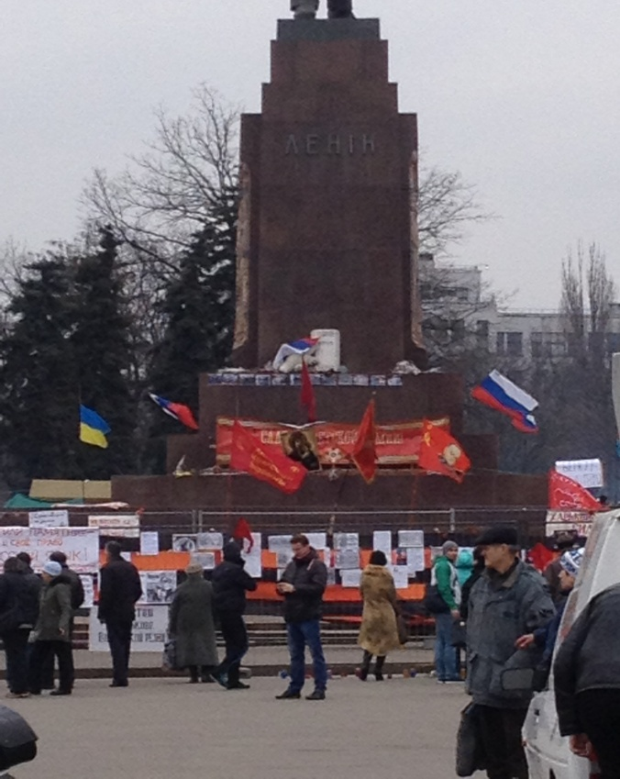
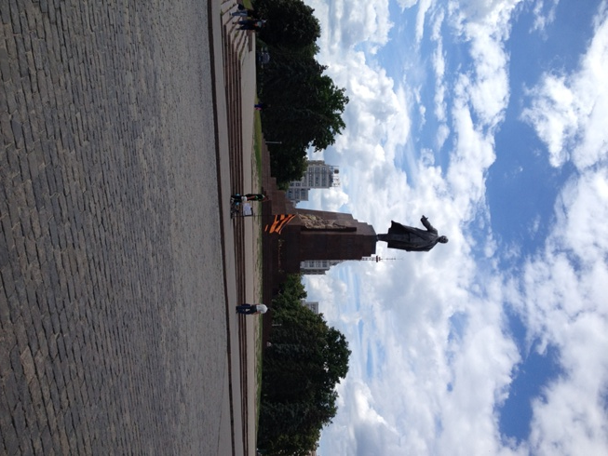
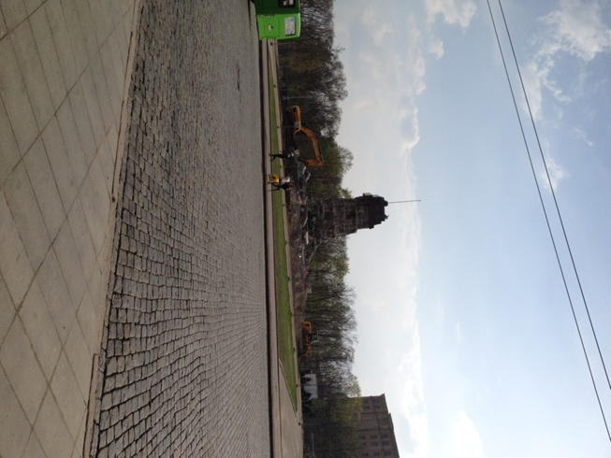
Kharkiv: Goodbye Lenin

Slide 22
Public Opinion
At the end of 2015 a total of 60% of the population feel that the events in Ukraine are unfolding in the wrong direction
The main signal that the country has started to go in “the right direction” for the majority of the population would be putting an end to the war, establishing peace in the Donbas (73%), overall growth of the Ukrainian economy (56%), the overall growth in the standards of living – i.e. pensions, wages and stipends (52%), criminal liability of corrupt officials (50%) rise an industry and the creation of new jobs(37%).
Notes:
Research, conducted by The Ilko Kucheriv Democratic Initiatives Foundation with the Kyiv International Institute of Sociology (KIIS) from December 15-25, 2015. A total of 2,040 respondents from the age of 18 and up were polled in all regions of Ukraine, exceptied the Crimean Autonomous Republic. In the Luhansk and Donetsk oblasts polling was conducted only on the territories controlled by Ukraine.

Slide 23
Trust / distrust in Ukrainian society
Leaders of Public Trust
Distrust Leaders
Volunteers – 68 %
Church – 62 %
NGOs – 46 %
Ukrainian Media – 47 %
Armed Forces of Ukraine – 44 %
Volonteering Batallions – 42%
President – 62 %
Government – 74 %
Political Parties – 87 %
Verkhovna Rada - 78 %
General Prosecutor’s Office – 79 %
Courts – 80 %
Russian Media – 84 %

Slide 24
Public Opinion (Foreign Policy)
In December 2015 a total of 57% of the people chose orientation towards accession to the EU, while only 13% were in favor of the Customs Union (Russia, Belarus, Khazakhstan)
43 % feels that the best variant to guarantee the security of Ukraine would be joining NATO
29% of the people support the neutral status of Ukraine, while support of a military union with Russia fell to a record low 5%

Slide 25
EU vs Custom Union: regional perspective
Western region is fully oriented towards the EU (85% vs 2%).
Central region: 63% EU versus 6% CU,
Southern regions: 27% EU versus 20% CU,
in the East of Ukraine these vectors are almost equal (29% and 30%)
In Donbas 24% – for EU membership and 33% – for the Customs Union.
However, in the Southern, Eastern and Donbas regions a significant part of the population is undecided as to their orientation (53%, 41% and 43%, respectively)
Number of proponents of NATO in Eastern Ukraine increased from 20% to 39%, while those in favor of a neutral status fell from 43% to 29%.

Slide 26
Public Opinion (Reforms)
In December 2014 a total of 43% of the population was ready to put up certain material hardships for the sake of reforms
in December 2015 the number of people ready to tolerate material problems for the sake of the success of reforms fell to 33%, 8% of which responded – however long it will take, while 25% – responded not more than a year. 59% said they will not tolerate it, 20% of which do not believe in the success of reforms

Slide 27
Reforms Agenda for Ukraine
Declared and ongoing
Decentralization (local government reform)
Reforms for fair Justice
Deregulation for business
Transparency and efficiency of state/ local authorities, E-Government
Humanitarian bloc (education, health care)

Slide 28
Cosmetic effects or first steps for real system changes?
New Police (Front Office )
Contract army (but still more than 400 Generals)
National Anticorruption Committee
New Law on Higher Education (University Autonomy, Rector elections, more close to Bologna Process)
New Legislation on Public Service, Political Parties, Local Elections

Slide 29
Conclusions
The “window of opportunity” for reforms closing fast
Perspectives of reconciliation and peace building on Donbas unclear – even for elites
Weak and ineffective state authorities vs strong civil society, which (optimistically) could influence and control changes
External pressure and support is highly important for reforms

Slide 30
Usefull Links
Authorities: www.rada.gov.ua, www.kmu.gov.ua, www.president.gov.ua
Reforms Monitor and initiatives http://carnegieendowment.org/specialprojects/Ukraine/, http://rpr.org.ua/en/,
Civil society, Media: www.stopfake.org/en, http://medialaw.org.ua/en, http://sprotyv.info/en, http://www.khpg.org/en/, http://www.irf.ua/, www.dif.org.ua
Elections: www.cvk.gov.ua, https://www.oporaua.org/en/, www.cvu.org.ua

